Slide 1
Software Engineering
EE422C

Slide 2
What is Software Engineering?
SWEs use a disciplined approach to the development of software-driven systems
SWE ! = programmer; SE is a relatively new field of study that applies to all types of systems that are developed as usable products
There are many different jobs that SWEs do
Software Engineering is a challenging career because of the inherent problems of software - as well as the rate of change in computing technologies, and the ever broadening range of applications

Slide 3
Software is complex
malleable
intangible
abstract
solves complex problems
interacts with other software and hardware
consequently, often software is buggy

Slide 4
What is a bug?
etymology [wikipedia]
perhaps first use of term in hardware engineering to describe mechanical failures, e.g., It has been just so in all of my inventions. The first step is an intuition, and comes with a burst, then difficulties arise—this thing gives out and [it is] then that "Bugs"—as such little faults and difficulties are called—show themselves and months of intense watching, study and labor are requisite before commercial success or failure is certainly reached. Thomas Edison, 1878

Slide 5
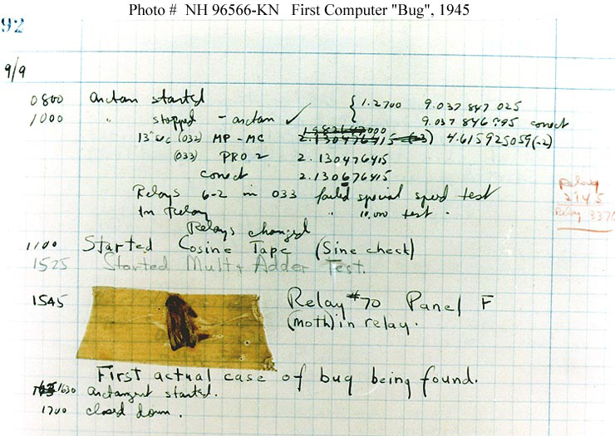
First actual case of bug being found
Harvard Mark II

Slide 6
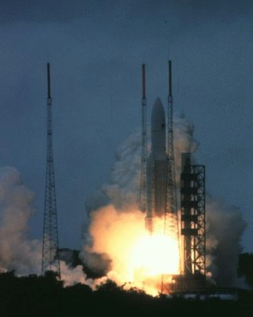
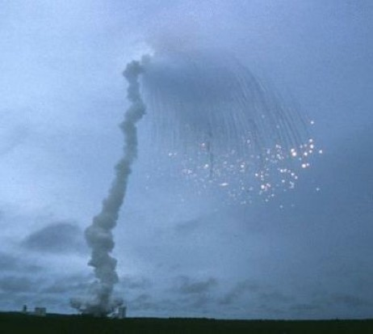
Ariane-5, 1996 crashed–went off-course 37 sec into flight sequence
Photos: ESA/CNES
Notes:
Crashed 37 sec after initiation of flight sequence
Unhandled numerical overflow exception
Details at: http://www.ima.umn.edu/~arnold/disasters/ariane5rep.html

Slide 7
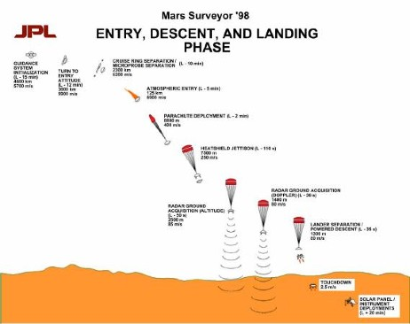
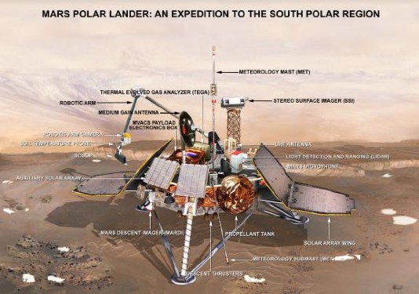
Mars polar lander, 1999 crashed–premature shut down at 40 meters altitude
Photos: JPL/NASA
Notes:
Crashed on landing
Descent engine to shut down prematurely
Error traced to a single bad line of code
Details at: ftp://ftp.hq.nasa.gov/pub/pao/reports/2000/2000_mpl_report_1.pdf

Slide 8
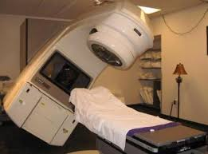
Therac-25
The Therac-25 was a radiation therapy machine produced by Atomic Energy of Canada Limited (AECL) in 1982 after the Therac-6 and Therac-20 units (the earlier units had been produced in partnership with CGR of France).

Slide 9
Therac-25 (cont.)
Involved in at least six accidents between 1985 and 1987, in which patients were given massive overdoses of radiation. Because of concurrent programming errors, it sometimes gave its patients radiation doses that were hundreds of times greater than normal, resulting in death or serious injury. These accidents highlighted the dangers of software control of safety-critical systems, and they have become a standard case study in health informatics and software engineering. (Wikipedia)

Slide 10
What is the Heartbleed bug?
Exploits a vulnerability in OpenSSL software library, used to implement the Transport Layer Security protocol used in web, instant messaging etc.
Exposes user’s passwords, cookies and other data to the attacker.
Not a virus.
One small bug in Open-Source software that made millions of computers vulnerable.

Slide 11
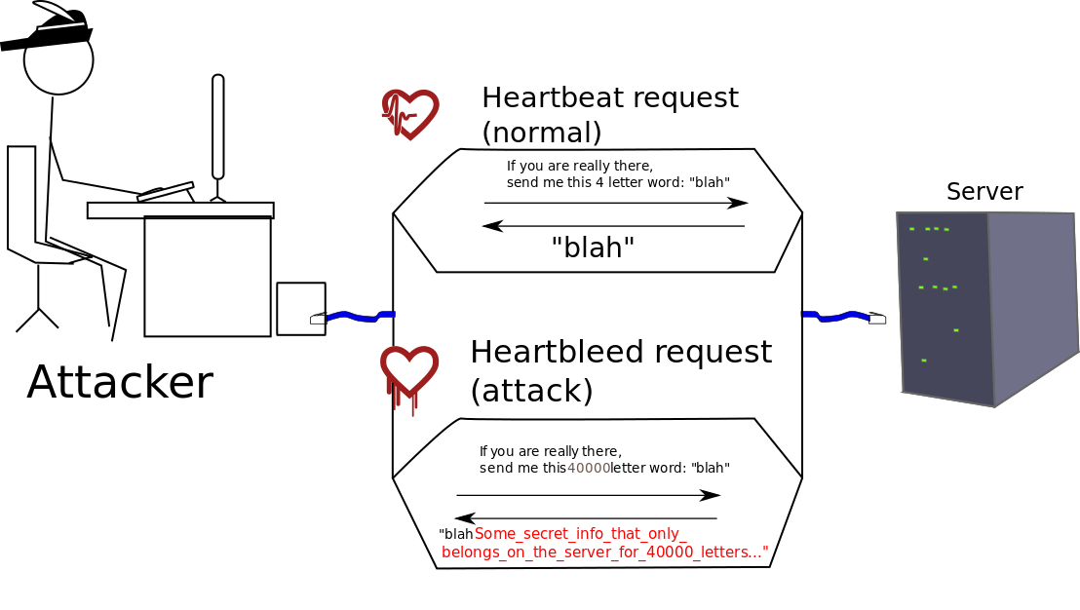
Heartbleed…

Slide 12
Buffer over-read bug
The extra data that is sent back is fetched from the server’s memory, due to the bug. It could include passwords and private keys.
Like if someone you had called in to fix your plumbing were to look through your closets for information.
Notes:
Russell and Norvig, Artificial Intelligence, a Modern Approach, 2003

Slide 13
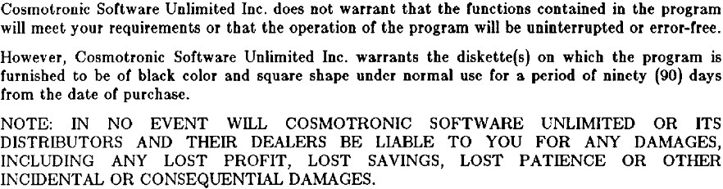
Warranties–two decades ago
ACM SIGSOFT Software Engineering Notes, Vol. 12, No. 3, July 87

Slide 14
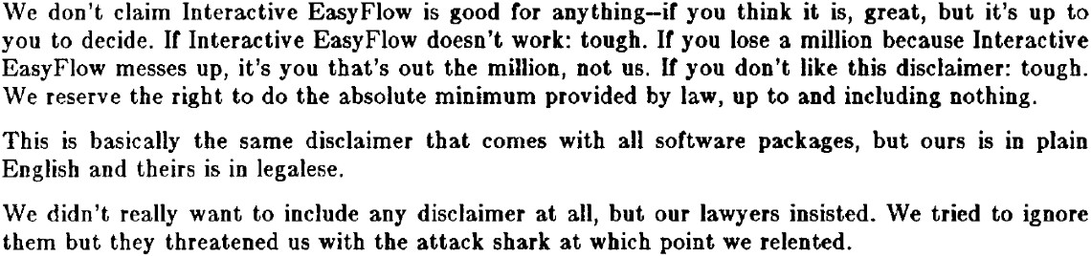
Warranties–two decades ago (cont.)
ACM SIGSOFT Software Engineering Notes, Vol. 12, No. 3, July 87

Slide 15
Warranties–today
Apple
“Apple warrants the media on which the Apple Software is recorded and delivered by Apple to be free from defects in materials and workmanship under normal use for a period of ninety (90) days from the date of original retail purchase.”
“... THE APPLE SOFTWARE IS PROVIDED "AS IS", WITH ALL FAULTS AND WITHOUT WARRANTY OF ANY KIND ...”
Google
“... is provided "as is," with no warranties whatsoever.”
Microsoft
“... the Software will perform substantially in accordance with the accompanying materials for a period of ninety (90) days ...”

Slide 16
Economic impact
“The Economic Impact of Inadequate Infrastructure for Software Testing” NIST Report, May 2002
$59.5B annual cost of inadequate software testing infrastructure
$22.2B annual potential cost reduction from feasible infrastructure improvements

Slide 17
Correctness
common (partial) properties
segfaults, uncaught exceptions
resource leaks
data races, deadlocks
specific properties
requirements
specification

Slide 18
Traditional waterfall model
requirements analysis
design checking
implementation unit testing
integration system testing
maintenance verification

Slide 19
Phases
Requirements
specify what the software should do
analysis: eliminate/reduce ambiguities, inconsistencies, and incompleteness
Design
specify how the software should work
split software into modules, write specifications
checking: check conformance to requirements

Slide 20
Phases (cont.)
Implementation
specify how the modules work
unit testing: test each module in isolation
Integration
specify how the modules interact
integration testing: test module interactions
system testing: test entire system
Maintenance
evolve software as requirements change
regression testing: test changes

Slide 21
Testing effort
Reported to be >50% of development cost [eg. Beizer’90]
Microsoft: 75% time spent testing
50% testers who spend all time testing
50% developers who spend half time testing

Slide 22
When to test
The later a bug is found, the higher the cost
orders of magnitude increase in later phases
also the smaller chance of a proper fix
Old saying: test often, test early
New methodology: test-driven development
write tests before code

Slide 23
Software still buggy
folklore: 1-10 (residual) bugs per 1000 lines of code (after testing)
consensus: total correctness impossible to achieve for complex software
risk-driven finding/elimination of bugs
focus on specific correctness properties

Slide 24
A Newer Approach
Agile Program Development
describes a set of values and principles for software development under which requirements and solutions evolve through the collaborative effort of self-organizing cross-functional teams. It advocates adaptive planning, evolutionary development, early delivery, and continuous improvement, and it encourages rapid and flexible response to change. These principles support the definition and continuing evolution of many software development methods. (Wikipedia)

Slide 25
Agile Development
Iterative, incremental and evolutionary
Short “sprints”
Planning, analysis, design, coding, unit testing, and acceptance testing for a subset of the larger problem.
Efficient and face-to-face communication
Customer and product manager are part of the team.
Very short feedback loop and adaptation cycle
Daily scrum (short meeting)
Quality focus
Continuous integration
Working product. Don’t break the build!

Slide 26
Pros and Cons
Pros
More flexibility
Immediate feedback. Helps customer determine needs.
Product always in a tested “release state”.
Finds bugs earlier. Everything is unit tested as it is built.
Cons
Flexibility can create “scope creep.”
Customer sees more possibilities as the product is created.
Harder to provide documentation
Because the features can change more rapidly, it can be harder to keep up with the product documentation.

Slide 27
Questions and comments

